Slide 1


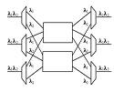
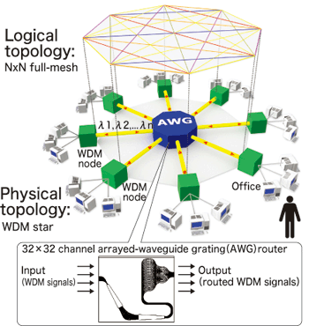
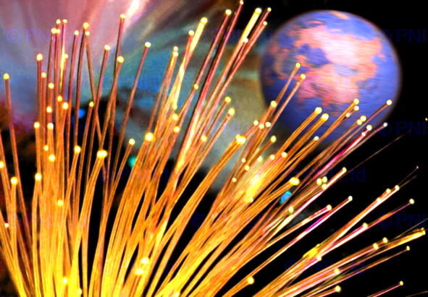
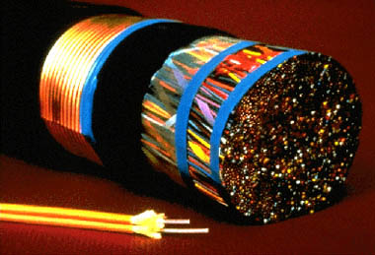
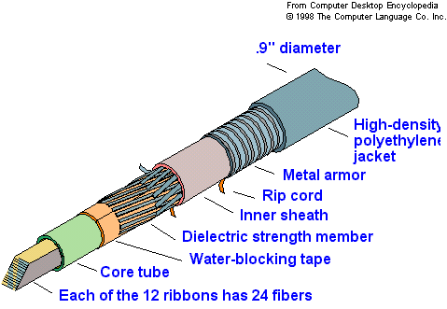
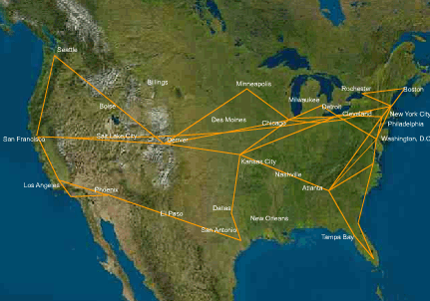
Routing and Survivability Issues in Optical WDM Networks
RWA problem: deals with finding a path/route from source to destination node with continuous and free wavelength along each link.
Survivability: deals with protection and restoration against fiber link failures in single and multi-domain optical networks.
Methodology
For RWA problem Parallel FFT, MRDR data partition pattern, simple embedding scheme with WA algorithm and a multi-level algorithm using iterated local search are used.
Survivable algorithms SPAVT, DDP, SPP-DiR PSIAG, LBHCP are used for protection against single-link and multi-link failures while TC_SSPP algorithm is used to shorten traffic recovery time from failures due to fiber cut.
Problem Issues
Open Issues
RWA problem for unidirectional and bidirectional hypercube communications, parallel matrix multiplication communication patterns is not clear.
Impact of backup routes on RWA with different network topologies is not determined.
Tolerating single-link and multi-link failures are not easy with shorter recovery time, as failures lead to a lot of data traffic blocked.
Survivability against single-link failures requires more switching ports which is not cost-effective.
Future perspectives will be focused on development of recombination operators and distributed algorithms for routing and wavelength assignment problem and various parallel communication patterns for RWA.
Future work will continue to study the impact on routing and wavelength assignment performance with alternate routes on different network topologies.
Research focus will be on to launch faster recovery schemes with optimal RU and new survivable mechanisms to provide protection against single-link failures.
New algorithms will be studied to tolerate multi-link failures with better RU, lower BP and higher protection ability.
Prepared by: Asima Nisar (52091) Supervised by: Dr. Syed Irfan Hyder

